Slide 1
Consolidation Exercise I
Redlining

Slide 2
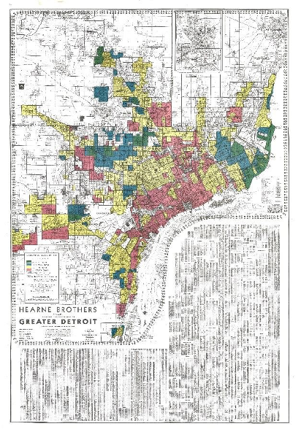
Redlining Data - context
In HW 2 we used list comprehensions, lambda function, user-defined classes and other python methods to simulate the problem of racial segregation in an abstract, decontextualized way
In HW 4 we will use all the python tools we have learned so far to explore real world data related to racial segregation in Detroit
Redlining is a historical practice in which ‘residential security maps’ were used to determine which residential areas would qualify for government-backed low interest rate mortgages.
In practice this ‘data-driven’ approach was used explicitly for the purpose of racial segregation.
The legacy of redlining has been to create a status quo in which race-neutral policies today can have the effect of reinforcing racial hierarchies.

Slide 3
Step 1 Retrieve Redlining Data
Using the python methods we learned in class, obtain the json file located at:
https://dsl.richmond.edu/panorama/redlining/static/downloads/geojson/MIDetroit1939.geojson and convert it from JSON to a python object
Note that .geojson can be treated simply as a JSON file
What type of object is it?
https://jamboard.google.com/d/1ZLdqlHAaWmyS4dmdIfLKAJEki8sgAWrZrf16UPcZ5BI/edit?usp=sharing

Slide 4
Step 2: Parse the Data - identify the structure
Explore the data and map out its underlying structure.
How many keys are there? What are they?
How many levels are there? What types of data structures are present in this python object?

Slide 5
Write pseudo-code to re-organize the data
We need to work with the coordinates, HOLC grade, and qualitative description for each district along with an identifier
Come up with a strategy for getting that information into a workable format

Slide 6
Convert Pseudocode into Code
Write code to collect coordinates, HOLC grade, and qualitative description for each district along with an identifier

Slide 7
Brainstorm - Connecting present day data to HOLC data
Present day data from the US Census can be located here: https://api.census.gov/data/2015/acs/acs5/variables.html
What variables do we want to interrogate with respect to the HOLC districts?
What is the structure of Census Data, and how can HOLC data be related to Census Data?

